Slide 1

Javascript DOM
DOM

Slide 2

Section 1. Understanding the document object model in javascript

Slide 3
Introduction
What is Document Object Model (DOM)
The Document Object Model (DOM) is an application programming interface (API) for manipulating HTML documents.
The DOM represents an HTML document as a tree of nodes. The DOM provides functions that allow you to add, remove, and modify parts of the document effectively.

Slide 4
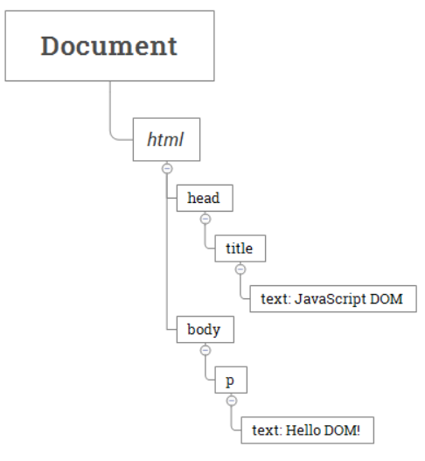
Introduction
A document as a hierarchy of nodes
The DOM represents an HTML document as a hierarchy of nodes. Consider the following HTML document: <html>
<head>
<title>JavaScript DOM</title>
</head>
<body>
<p>Hello DOM!</p>
</body>
</html>

Slide 5
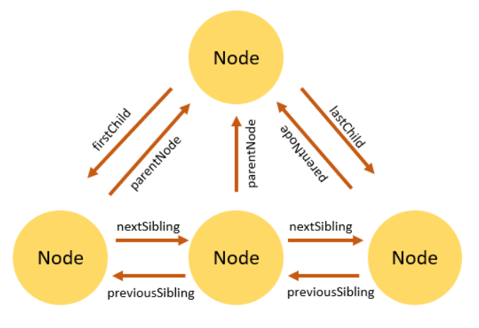
Node Relationships
What is Document Object Model (DOM)
Any node has relationships to other nodes in the DOM tree. The relationships are the same as the ones described in a traditional family tree.
For example, <body> is a child node of the <html> node, and <html> is the parent of the <body> node.
The <body> node is the sibling of the <head> node because they share the same immediate parent, which is the <html> element.
The following picture illustrates the relationships between nodes:

Slide 6
Section 2. Selecting elements

Slide 7

Selecting Elements
1st
2nd
3rd
4th
5th
getElementById() – select an element by id.
getElementsByName() – select elements by name.
getElementsByTagName() – select elements by a tag name.
getElementsByClassName() – select elements by one or more class names.
querySelector() – select elements by CSS selectors.

Slide 8
1st javascript getElementById() method
The document.getElementById() method returns an Element object that represents an HTML element with an id that matches a specified string.
If the document has no element with the specified id, the document.getElementById() returns null.
Because the id of an element is unique within an HTML document, the document.getElementById() is a quick way to access an element.

Slide 9
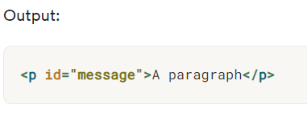
Javascript getElementById() method Example.
Suppose you have the following HTML document: <html>
<head>
<title>JavaScript getElementById() Method</title>
</head>
<body>
<p id="message">A paragraph</p>
</body>
</html> The document contains a <p> element that has the id attribute with the value message:
const p = document.getElementById('message');
console.log(p);

Slide 10

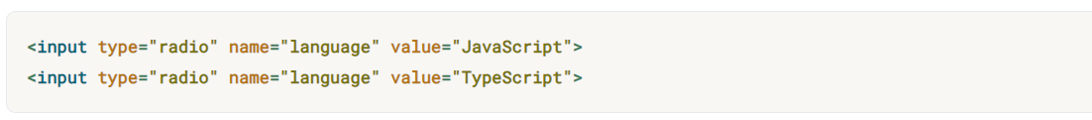

2nd javascript getElementsByName() method
Every element on an HTML document may have a name attribute:
Unlike the id attribute, multiple HTML elements can share the same value of the name attribute like this:
To get all elements with a specified name, you use the getElementsByName()
The getElementsByName() returns a live NodeList of elements with a specified name.
The NodeList is an array-like object, not an array object.

Slide 11

3nd javascript getElementsByTagName() method
The getElementsByTagName() method accepts a tag name and returns a live HTMLCollection of elements with the matching tag name in the order which they appear in the document. The following illustrates the syntax of the getElementsByTagName():
The getElementsByTagName() is a method of the document or element object.
The getElementsByTagName() accepts a tag name and returns a list of elements with the matching tag name.
The getElementsByTagName() returns a live HTMLCollection of elements. The HTMLCollection is an array-like object.

Slide 12

4nd javascript getElementsByClassName() method
The getElementsByClassName() method returns an array-like of objects of the child elements with a specified class name.
The method returns the elements which is a live HTMLCollection of the matches elements. Use the JavaScript getElementsByClassName() method to select the child elements of an element that has one or more give class names.

Slide 13

5nd javascript querySelector() and querySelectorAll() methods
The querySelector() method allows you to select the first element that matches one or more CSS selectors.
The following illustrates the syntax of the querySelector() method:
In this syntax, the selector is a CSS selector or a group of CSS selectors to match the descendant elements of the parentNode If the selector is not valid CSS syntax, the method will raise a SyntaxError exception.
If no element matches the CSS selectors, the querySelector() returns null.

Slide 14

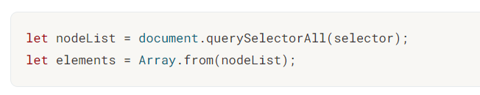
querySelectorAll() methods
Besides the querySelector(), you can use the querySelectorAll() method to select all elements that match a CSS selector or a group of CSS selectors:
The querySelectorAll() method returns a static NodeList of elements that match the CSS selector. If no element matches, it returns an empty NodeList.
Note that the NodeList is an array-like object, not an array object.

Slide 15

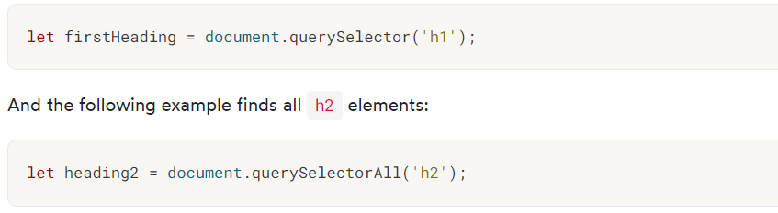
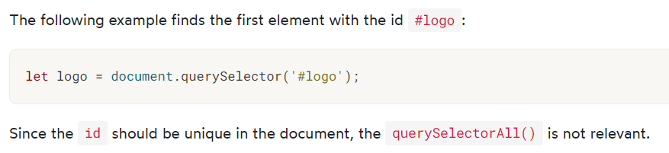
querySelectorAll() methods
1) Universal selector:- The universal selector is denoted by * that matches all elements of any type:
2) Type selector:- To select elements by node name, you use the type selector e.g., a selects all <a> elements: The following example finds the first h1 element in the document:
4) ID Selector:-

Slide 16
Section 3. Traversing elements

Slide 17
Section 3. Traversing elements
1st
2nd
3rd
Get the parent element –
get the parent node of an element.
Get child elements –
get children of an element.
Get siblings of an element –
get siblings of an element.

Slide 18

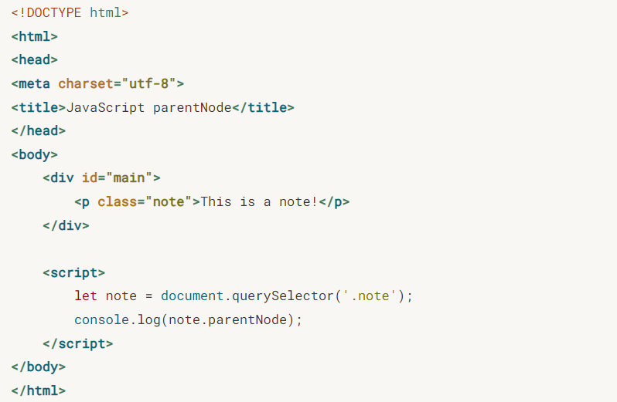
1st JavaScript Get the Parent Element parentNode
To get the parent node of a specified node in the DOM tree, you use the parentNode property:

Slide 19


2st Getting Child Elements of a Node in JavaScript
Get the first child element
To get the first child element of a specified element, you use the firstChild property of the element:
Or to get the first child with the Element node only, you can use the firstElementChild property:
Get the last child element:- To get the last child element of a node, you use the lastChild property:

Slide 20


2st Getting Child Elements of a Node in JavaScript
Get all child elements
To get a live NodeList of child elements of a specified element, you use the childNodes property:
The childNodes property returns all child elements with any node type.
To get the child element with only the element node type, you use the children property:

Slide 21
Summary
The firstChild and lastChild return the first and last child of a node, which can be any node type including text node, comment node, and element node.
The firstElementChild and lastElementChild return the first and last child Element node.
The childNodes returns a live NodeList of all child nodes of any node type of a specified node. The children return all child Element nodes of a specified node.

Slide 22
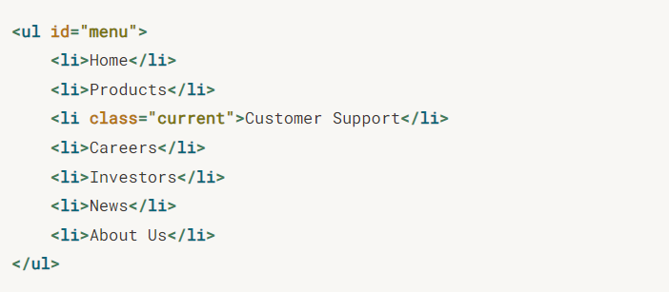

3st JavaScript Siblings
Let’s say we have the following list of items:
:
Get the next siblings:
To get the next sibling of an element, you use the nextElementSibling attribute:

Slide 23
JavaScript Siblings
Get all siblings of an element
To get all siblings of an element, we’ll use the logic:
First, select the parent of the element whose siblings you want
define a function name that takes the selected element as an argument.
initialize a variable name with the first child element of the parent.
enter a while loop . within the loop, check if the current sibling is an element node (nodeType === 1) and not equal to the original element. if the condition is met, push the sibling into the array. move to the next sibling using sibling.nextSibling. continue looping until there are no more siblings.
return the array of siblings from the function.
call the function with the selected element as a parameter..

Slide 24
Section 4. Manipulating elements

Slide 25
Section 4. Manipulating elements
1st
2nd
3rd
4th
5th
createElement() – create a new element.
appendChild() – append a node to a list of child nodes of a specified parent node.
textContent – get and set the text content of a node.
innerHTML – get and set the HTML content of an element. innerHTML vs. createElement – explain the differences between innerHTML and createElement when it comes to creating new elements.
querySelector() – select elements by CSS selectors.

Slide 26


JavaScript CreateElement
To create an HTML element, you use the document.createElement() method:

Slide 27

JavaScript appendChild
To create an HTML element, you use the document.createElement() method: The element.appendChild() appends an HTML element to an existing element.

Slide 28


JavaScript appendChild
Reading textContent from a node:
To get the text content of a node and its descendants, you use the textContent property:
Setting textContent for a node:
Besides reading textContent, you can also use the textContent property to set the text for a node:

Slide 29
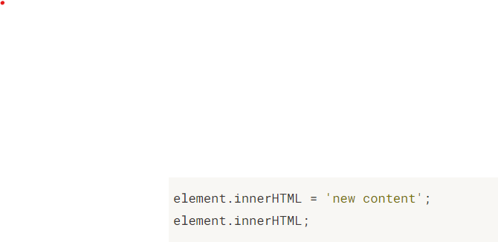

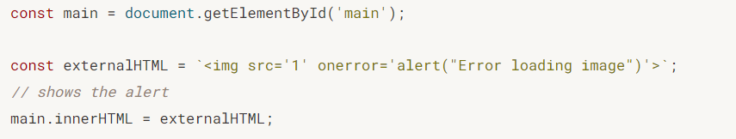
JavaScript innerHTML
The innerHTML is a property of the Element that allows you to get or set the HTML markup contained within the element:
Reading the innerHTML property of an element:
To get the HTML markup contained within an element, you use the following syntax:
Setting the innerHTML property of an element:
To set the value of innerHTML property, you use this syntax:

Slide 30

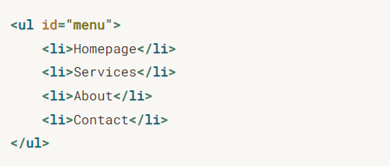
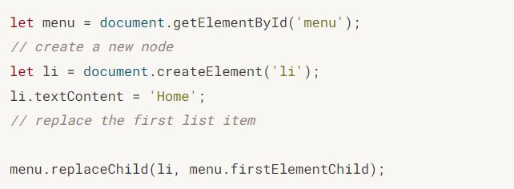
JavaScript replaceChild
To replace an HTML element, you use the node.replaceChild() method:
In this method, the newChild is the new node to replace the oldChild node which is the old child node to be replaced.

Slide 31


JavaScript removeChild
To remove a child element of a node, you use the removeChild() method:

Slide 32
Section 5. Working with Attributes

Slide 33
Section 5. Working with Attributes
1st
2nd
3rd
setAttribute() – set the value of a specified attribute on a element.
getAttribute() – get the value of an attribute on an element.
removeAttribute() –
remove an attribute from a specified element.

Slide 34

1st JavaScript setAttribute() method
To set a value of an attribute on a specified element, we use the setAttribute() method:
Parameters:-
The name specifies the attribute name whose value is set. It’s automatically converted to lowercase if you call the setAttribute() on an HTML element.
The value specifies the value to assign to the attribute. It’s automatically converted to a string if you pass a non-string value to the method. Example:-
First, select the button with the id btnSend by using the querySelector() method.
Second, set the value of the name attribute to send using the setAttribute() method.
Third, set the value of the disabled attribute so that when users click the button, it will do nothing.

Slide 35
2nd JavaScript getAttribute() method
To get the value of an attribute on a specified element, you call the getAttribute() method of the element:
Get the value of an attribute of a specified element by calling the getAttribute() method on the element.
The getAttribute() returns null if the attribute does not exist.

Slide 36

3rd JavaScript removeAttribute() method
The removeAttribute() removes an attribute with a specified name from an element:

Slide 37
Section 6. Manipulating Element’s Styles

Slide 38
Section 6. Manipulating Element’s Styles
1st
^{2nd}
style property – get or set inline styles of an element.
classList property –
manipulate CSS classes of an element.

Slide 39


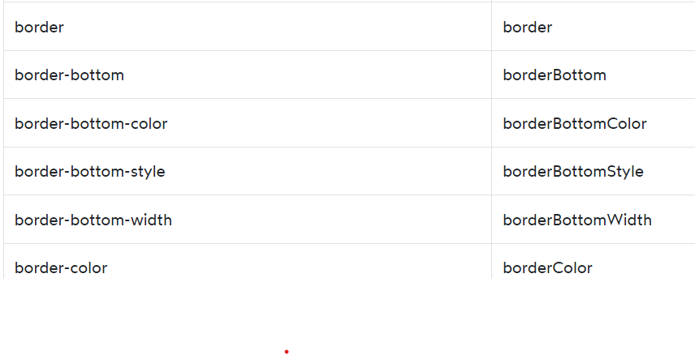
1st JavaScript Style
To set the inline style of an element, you use the style property of that element:
The style property returns the read-only CSSStyleDeclaration object that contains a list of CSS properties.
To completely override the existing inline style, you set the cssText property of the style object.

Slide 40


2nd JavaScript classList property
The classList is a read-only property of an element that returns a live collection of CSS classes:
The classList is a DOMTokenList object that represents the contents of the element’s class attribute.
1) Get the CSS classes of an element
Suppose that you have a div element with two classes: main and red. 2) Add one or more classes to the class list of an element
To add one or more CSS classes to the class list of an element, you use the add() method of the classList.
3) Remove element’s classes
To remove a CSS class from the class list of an element, you use the remove() method:

Slide 41

Thank you
Muhammad Latif
ml129kmg@gmail.com

